Slide 1
DRAW 7 BASIC SHAPES
By: James Zartman
METC-220

Slide 2
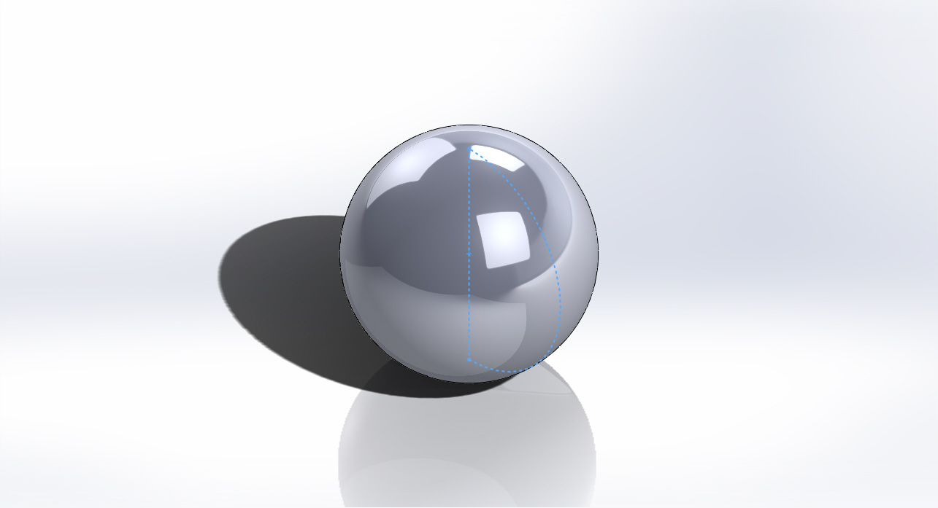
Sphere
Steps to make
End Result
Start with a new sketch and select the front plane as normal to plane
Draw a center point circle at the origin and smart dimension to 1 inch diameter
Draw a line intersecting the circle from top to bottom
Trim away excess line and half of the circle
Revolve boss/base the half circle around the intersecting line.
Makes sure it is set to 360 degrees and click the check mark
Hit CTRL 7 for Isometric View

Slide 3
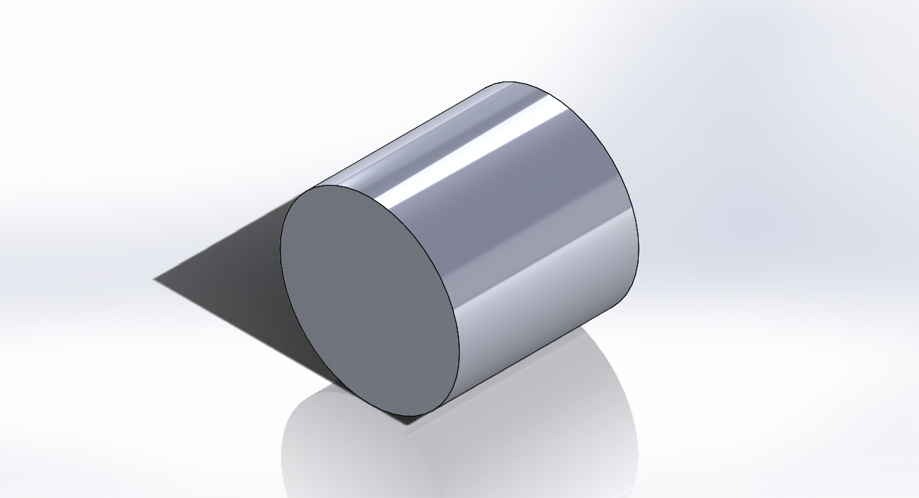
Cylinder
Steps to Make:
End Result
Start with a new sketch and select the front plane as normal to plane
Under sketch tab draw a center point circle at the origin
Smart dimension to 1 inch diameter
Then click on the features tab and click extruded boss/base button
Enter dimension of 1 inch for the extrusion
Click check mark
Hit Ctrl 7 for Isometric view

Slide 4
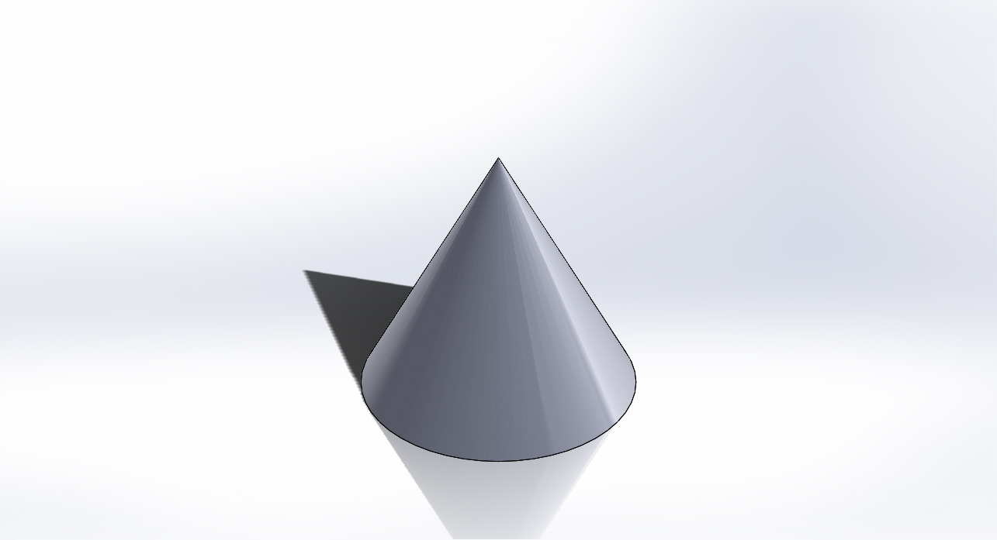
Cone
Steps To Make:
End Result
Start with a new sketch normal to the front plane
From the sketch tab draw a right triangle with a height of 1” and a base of .5”
Go features tab and click on revolve boss/base
Click on 1” side of triangle to be axis to revolve
Click check mark
Hit CTRL 7 for isometric view

Slide 5
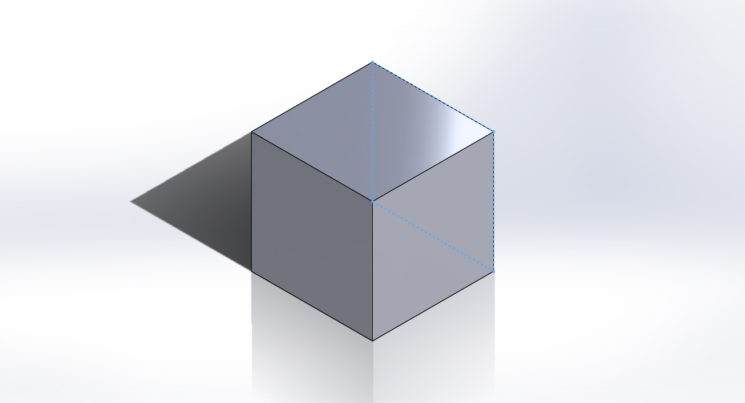
Box
Steps To Make:
End Result
Start with a new sketch normal to the front plane
From the sketch tab draw a center point rectangle
Smart dimension the rectangle to 1” by 1”
Go to features tab and click Extruded boss/base
Select 1” for the extrusion
Click check mark
Hit CTRL 7 for Isometric view

Slide 6
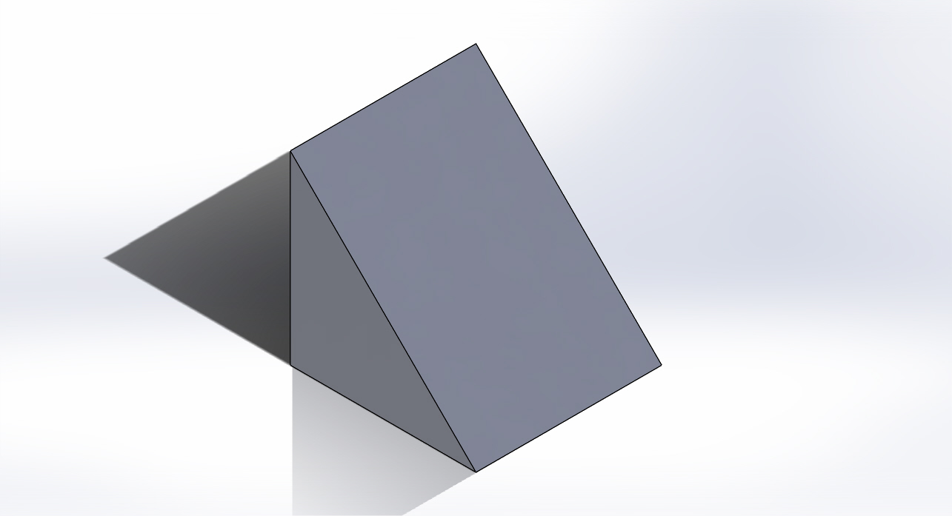
Wedge
Steps To Make:
End Result
Start with a new sketch normal to the front plane
From the sketch tab draw a right triangle with a height of 1” with a base of 1”
Go to features tab and click Extruded boss/base
Select 1” for the extrusion
Click the check mark
Hit CTRL 7 for the isometric view

Slide 7
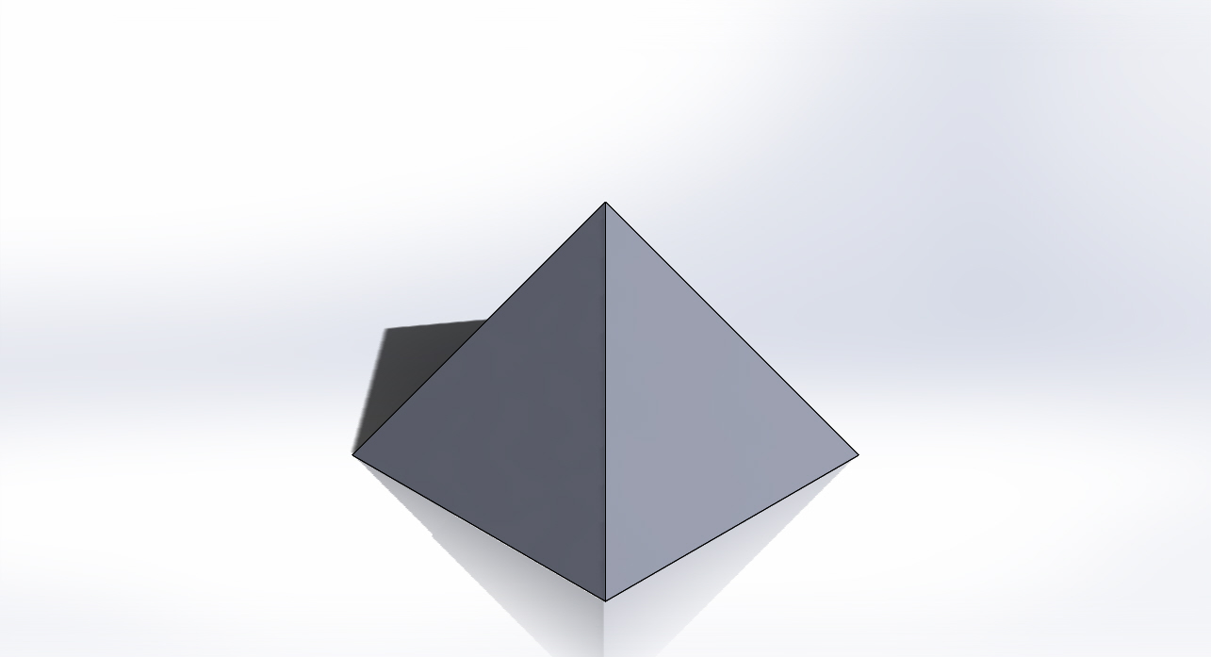
Pyramid
Steps To Make:
End Result
Start with a new sketch normal to the top plane
From the sketch tab draw a 1” by 1” rectangle
From features tab click extruded boss/base
Select 1” for the extrusion
From features tab select draft, click bottom of box to be neutral plane and then select 4 sides of the box to be draft planes
Select 30 degrees to be draft angle, and reverse the direction
Click check mark
Hit CTRL 7 for isometric view

Slide 8
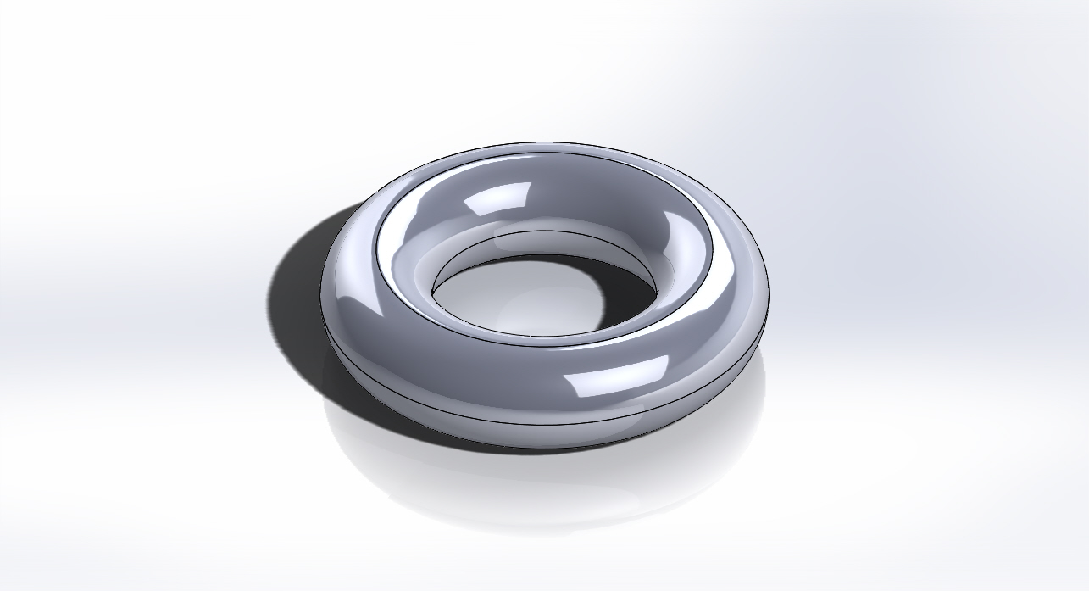
Taurus
Steps To Make:
End Result
Start with a new sketch normal to the top plane
From sketch tab draw a center point circle at the origin with a diameter of 1”
Within the circle draw another center point circle at the origin with a diameter of .5”
From features tab click on extruded boss/base for the outer circle of .25”
Click on fillet and select the .125 as the dimension of fillet for all edges
Click check mark
Hit CTRL 7 for isometric view

